Slide 1




How I Learned to Love Dependency Injection James Bender github.com/JamesBender

Slide 2
Why Dependency Injection?

Slide 3

The Pursuit of the Loosely Coupled System

Slide 4


Slide 5
SOLID Princples

Slide 6
SOLID Princples
Liskov Substitution Principle
Any object in your application should be able to be replaced with a type derived from it without breaking the application

Slide 7
SOLID Princples
Dependency Inversion Principle
Code should depend on abstractions; not concrete implementations. Furthermore, the abstractions should not depend on the details; the details should depend on the abstractions

Slide 8
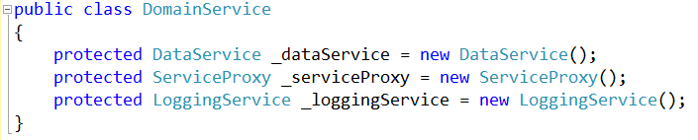
Basic Entity-Based Architecture
Database Access Service
Domain Service
Database Access Service
Service Proxy
Logging Service
Etc..
Service Proxy
Logging Service
Tightly coupled services!

Slide 9

Doesn’t promote reusability
Creates brittle systems
Difficult to “mock” makes testing difficult

Slide 10
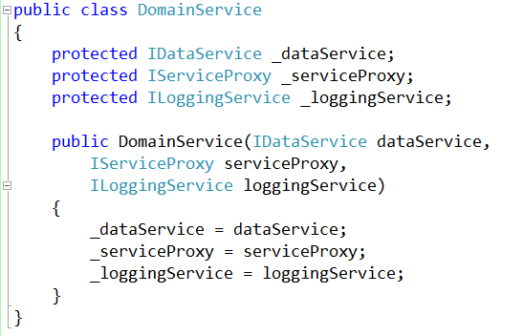
With Dependency Injection

Slide 11

Better….
… but still a lot of work
There are so many dependencies in this system, how do I manage them all?

Slide 12
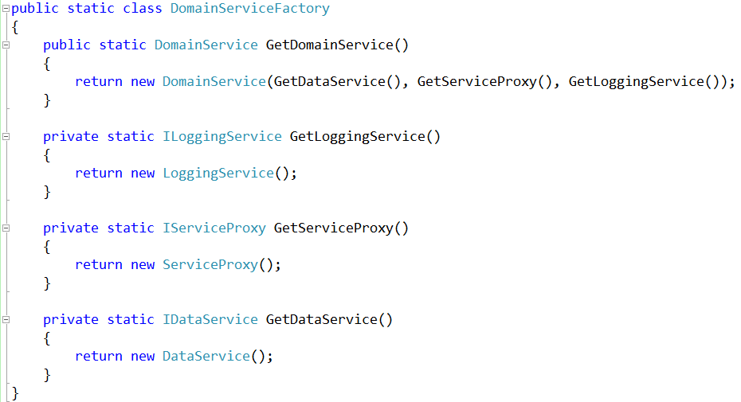
Dependency Injection With a Factory Pattern
Domain Service
“I need to be created, including have all my services crated and given to me.”
Create a
Concrete instance
Object Factory
“ I know how to build all of this stuff.”
Create an
Entity for me
Instance for
application
Application
“I need an Domain Service but I don’t how to create it.”

Slide 13

I want to spend my day writing functional business code, NOT being a plumber…

Slide 14
Dependency Injection Frameworks to the Rescue!

Slide 15
With a Dependency Injection Framework
Application
“I need a concrete instance of a Service…”
Domain Service
Database Access Service
Service Proxy
Logging Service
Etc..
Provider
“You tell me what type of object you want, I give you the object you need:”
Kernel
“You ask me for objects, I create them based on the provided mappings and rules”

Slide 16
DEMO TIME!

Slide 17
Some Popular .NET Dependency Injection Frameworks
Structure Map
Ninject
Microsoft Unity

Slide 18

Thank you!
Want to learn more?
www.JamesCBender.com
github.com/JamesBender
james@jamescbender.com
Twitter: @JamesBender
hallwayconversations.com

